Slide 1

Welcome

Slide 2
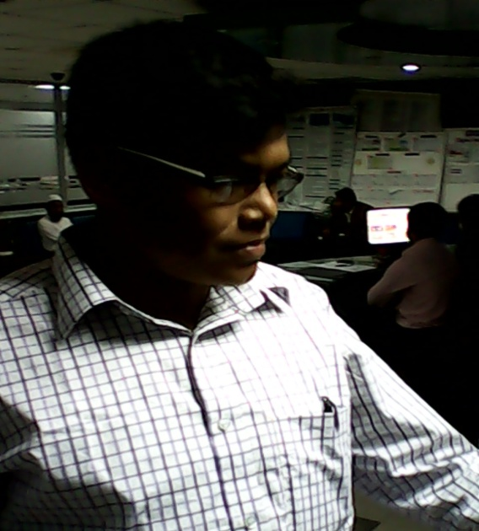
IDENTITY OF TEACHER
Md. Abu Abdur Rahman Siddiquee
Senior Assistant Teacher (English)
Jagarani M. L Girls’ High School
Newashi, Nageswari, Kurigram.
E-mail: siddiquee1211@gmail.com
Contact No. 01743943113

Slide 3

IDENTITY OF LESSON
Subject: English 2nd paper
Subject Code: 108
Class : 8
Present Ss:----
Total Ss:----
Duration: 50 Minutes
Date:--/--/20--

Slide 4
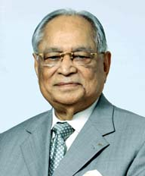
Look at the sentences;
Mr. Chowdhury was an honest man.
Mr. Chowdhury was not a dishonest man.
He was an educated person.
He was not an uneducated person.

Slide 5
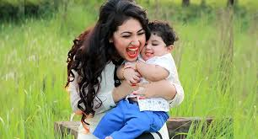
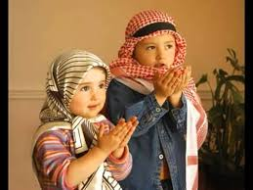
Every mother loves her child.
There is no mother but loves her child.
Only Allah can help us.
None but Allah can help us.

Slide 6
The lesson you’ll learn today
Transformation of sentences
Affirmative to Negative

Slide 7
LEARNING OUTCOMES
At the end of the lesson, students will be
able to …
identify affirmative and negative sentences.
change and write them according to rules.

Slide 8
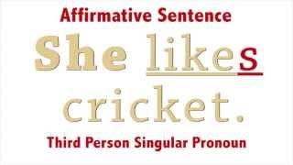
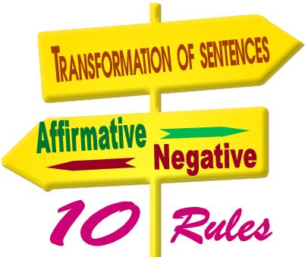
Transformation means the structural change of a sentence without changing the meaning of the sentence.

Slide 9
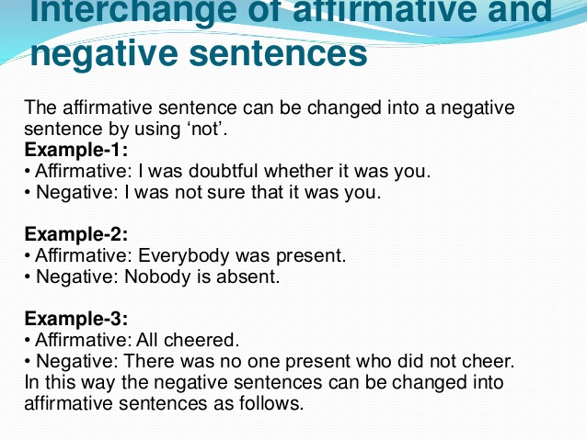
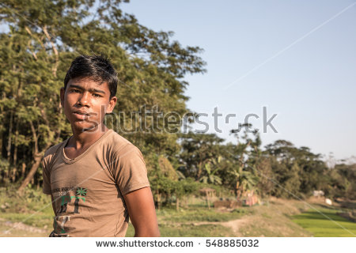
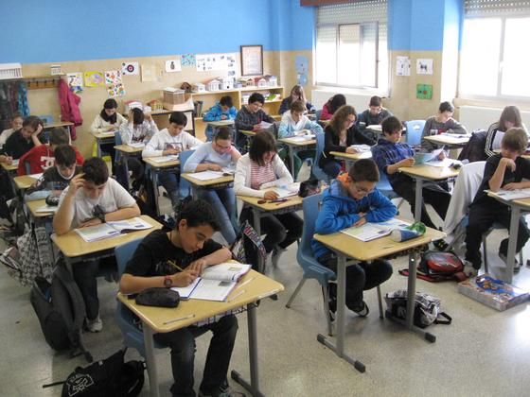
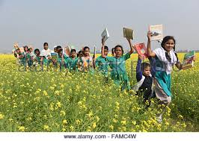

Slide 10
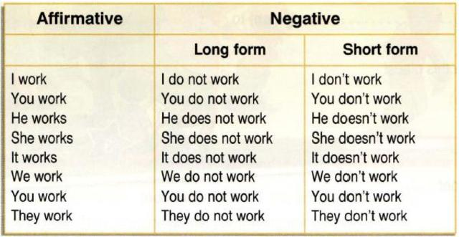

Slide 11
Change the following affirmative sentences into negatives.
In the simple present tense, we make negative forms by putting ‘not’ after ‘do’ or ‘does’. Note that ‘do’ is used when the subject is a plural noun or pronoun. The first person pronoun ‘I’ also takes the verb ‘do’. ‘Does’ is used when the subject is a singular noun or pronoun.
In the simple past tense, we make negatives by putting ‘did not’ before the base form of the verb.
My sister lives with my parents.
2. I know the answer.
3. I want to leave now.
4. My mother works at a bank.
5. Supriya sings really well.
6. Martin gets along with his brother-in-law.
7. The boy killed the spider with his shoe.
8. She recognized him at once.
9. He apologized for his conduct.

Slide 12
Answers :
1. My sister does not live with my parents.
2. I do not know the answer.
3. I do not want to leave now.
4. My mother does not work at a bank.
5. Supriya does not sing very well.
6. Martin does not get along with his brother-in-law.
7. The boy did not kill the spider with his shoe.
8. She did not recognize him at once.
9. He did not apologize for his conduct.

Slide 13
Affirmative | Negative
Only/Alone (person) Only Allah can help us. | None but None but Allah can help us.
Only (things) Only the pen is for you. | Nothing but Nothing but the pen is for you.
Only (number/mea- surement) I need only ten taka . | Not more than/ Not less than I need not more/less than ten taka.

Slide 14
Affirmative | Negative
Must/can/ have to/has to/ Need to/had to Imran must do it. | Can not but/could not but + V1/can not help +V-ing Imran can not but do it.
Both… and …/and/besides Both Kanon and kakon can do it. | Not only… but also Not only Kanon but also kakon can do it

Slide 15
Affirmative | Negative
Every+ Noun+V+O Every mother loves her child. | There is no… but There is no…who +negative No…+ opposite verb There is no mother but loves Her child.
Every/All+Noun+be+adj All men are mortal. | No+ noun+be+adj – opposite word No man is immortal.
As soon as (both clauses- past Indefinite) As soon as I entered the classroom, the bell rang. | No sooner had…than… Scarcely had… when… Hardly had… when… No sooner had I entered the classroom than the bell rang.

Slide 16
Affirmative | Negative
Too..(adj/adv) + to + v He is too weak to walk. | So..(adj/adv) + that + S2 +can’t/couldn’t+V1 He is so weak that he can’t walk.
Sometimes The poor are sometimes happy. | not/don’t/doesn’t/didn’t Always The poor are not always happy.
Universal truth The sun rises in the east. | Negative- Interrogative Doesn’t the sun rise in the east?

Slide 17
Affirmative | Negative
For the last time/ for good/ For ever I have come here for the last time. | Never again shall Never again shall I come here.
Many I have many friends. | not a few I have not a few friends.
Comparative/ superlative degree He is better than any other boy. | Positive degree No other boy is as good as he.

Slide 18
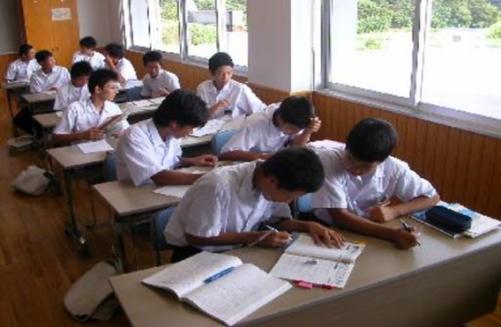
PAIR WORK
Change the following sentences into ‘Negative’ .
By working hard, they can improve their
condition.
They are always sincere to their duties.
She was a very hardworking and responsible
loanee.
Everybody wants friends.
Books are our real friends in our life.
Nazneen belongs to a small family.

Slide 19

Transform the sentences into ‘Affirmative.’
G
ROUP WORK
None but the fool will say so.
Jim was never late.
You can not help going there.
I did not find many people there.
No sooner had I reached the college than
the bell rang.
There is no mother but loves her child.
No one will deny his courage.
Smoking is not only a dangerous habit
but also a bad one.

Slide 20

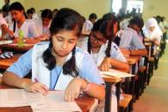
ASSESSMENT OF LEARNING
Change the sentences into ‘Negative’ .
Tea is a popular drink.
His wife Catherine loves gardening.
We must be grateful and kind to the cow.
He passed his early life in sorrows.
Everybody must be conscious of health.
They are honest and pious.
As soon as he saw the police, he ran away.
The beggar was too poor to lead a hand
to mouth.
Everybody wishes to be happy in life.

Slide 21

HOME WORK
Transform the following sentences:
Jerry was not a dishonest boy. (Aff)
I will always remember this day. (Neg)
At first he only treated animals. (Neg)
You cannot help going there. (Aff)
No man is free from error. (Aff)
He acted wisely. (Neg)
He is fit for the post. (Neg)

Slide 22



